Slide 1
Belief

Slide 2
belief (Hebrews 11:30)
What if your professor tells you that everything you’ve been taught in class will help, but the half of them, will be proven incorrect. The bad news is we have no way of knowing which half is which!
It is some time difficult to know what to believe about much of the information we’re fed.
One day we read that drinking alcohol is harmful. The next week other reports indicate that it is protective of good health.
Chocolate is fattening, right? Wait a munite now a group of researchers has reported that it actually helps to lose weight.
Coffee is harmful, we’ve been told. But then we learn that in a significant study those who drank large amounts of coffee lived longer!

Slide 3
Cont’d...
In what or who can we truly believe?
It is difficult to answer this question!
Yet, we all believe in something.
The greatest skeptics (attitude, doubt) have beliefs, even if it is the belief that no one can be trusted.
The survival of all humans is based on beliefs of some kind.
Belief is essential to human existence and organization.

Slide 4
Power of belief
Beliefs are the mental attitudes and convictions we hold about ourselves, others, and the world around us. They shape our perceptions, determine our behaviors, and impact our overall well-being.
Self-fulfilling prophecy: When we strongly believe in something, it can become a self-fulfilling prophecy.
Our beliefs influence our thoughts and actions, which in turn shape our behaviors and outcomes.
For example, if someone strongly believes they are not good enough to succeed, they may not put in the necessary effort, leading to a lack of success and reinforcing their initial belief.

Slide 5
Cont’d...
Mind-body connection: Beliefs can have a profound impact on our physical and mental health.
Research has shown that positive beliefs, such as believing in one's ability to recover from an illness, can enhance the healing process.
Similarly, negative beliefs and stress can have detrimental effects on our well-being.
The mind-body connection highlights the interplay between our thoughts, beliefs, emotions, and physical health.

Slide 6
Cont’d...
Motivation and goal achievement: Beliefs play a crucial role in motivation and goal achievement.
When we believe in our capabilities and have a strong belief in the possibility of achieving our goals, we are more likely to take action and persist in the face of challenges.
Belief acts as a driving force that fuels our efforts and helps us overcome obstacles.

Slide 7
Improved quality of life
Spirituality can play a significant role in improving the quality of life for many individuals.
While spirituality can have different meanings for different people, it generally involves seeking a sense of connection, meaning, and purpose in life, and exploring deeper questions about existence and the nature of reality.

Slide 8
Cont’d...
Individuals with strong religious faith report higher levels of life satisfaction, greater personal happiness, and fewer negative psychological consequences of traumatic life events.
Spirituality not only helps believers but also benefits the non believers in their community.
Researchers found that communities get health benefits when they have higher numbers of adherents to faith that emphasize obedience to God and his standard of conduct.

Slide 9
Cont’d...
Religious people particularly adolescents from religious homes who frequently attend religious services, pray and read scripture have fewer problems with alcohol, tobacco, or other drugs than do their nonreligious peers.
Proverbs 4;18: The path of the righteous is like the morning sun, shining ever brighter till the full light of day.
Ps. 119:165: Great peace have they which love thy law: And nothing shall offend them.

Slide 10
Stress issues
Belief in God may be associated with reduction in stress, depression and loneliness. According to many reports it has been revealed that a large number of people live with chronic feeling of loneliness.
At least two thirds of Americans feel stressed at least once a week.
Stress, depression and loneliness can have serious consequences.
Stress causes an increase in blood glucose leading to diabetes in those who are predisposed
Stress may cause the release of an hormone (adrenalin) resulting to the heart beat more rapidly and powerfully.

Slide 11
Benefits of prayer
Stress reduction: Engaging in prayer can provide a sense of comfort, solace, and inner peace. It can be a form of relaxation that helps reduce stress levels, promote emotional well-being, and provide a sense of calmness during challenging times.
Talking to God as to a friend, telling him all our joys, sorrows, can bring happiness, healing, and religious satisfaction.
Positive emotions: Prayer can evoke positive emotions such as gratitude, love, compassion, and forgiveness.

Slide 12
Spiritual and moral values
Belief in spiritual values has been a strong motivator to treat others well and to develop peaceful human relatioships.
History demonstrates that faithless and amoral societies become so corrupt that they cannot survive. Belief is fundamental to science as well as to religion.
Studies indicate that those with regular spiritual practices who meet with a faith community live longer, live better, and are far less likely to have a stroke or heart attack.
Faith can provide strength to overcome stress and destructive habits.
Belief can give you peace of mind and enable you to reach your full potential through positive choices.
Celebrate belief it is the foundation of life!

Slide 13
Peace of mind
Isaiah 26:3: The Bible says ‘’You will keep him in perfect peace, Whose mind is stayed on You, Because he trusts in You’’.
When we have a close relationship with God, we experience peace of mind.
This does not mean that those who believe in God and trust him absolutely will be free from problems.
Trouble and turbulence may surround us, yet we enjoy a calmness and peace of mind of which the world knows nothing.
The peace of the Christian depends not upon peaceful conditions in the world about him but upon the indwelling of the Spirit of God.

Slide 14
Cont’d...
Trust in yourself, and you are doomed to disappointment.
Trust in your friends, and they will die and leave you.
Trust in money, and you may have it taken from you.
Trust in reputation, and some slanderous tongue may blast it.
But trust in God, and you will never be confounded in time or eternity

Slide 15
Rest
Matthew 11:28 “Come to me, all you who are weary and burdened, and I will give you rest.
Psalm 62:1 “Truly my soul finds rest in God; my salvation comes from him”.
Tired minds are much more likely to make serious mistakes. In most societies of the world today, a significant percentage of the population is sleep deprived.
Without rest and relaxation all humans suffer cognitive impairments. Tired people become inefficient, slower, less safe, and make more mistakes.
To remain at the top of our game we need adequate sleep every night.

Slide 16
Sleep deprivation:
There have been many attempts to increase productivity by extending the workweek and daily working hours.
They have all failed because we each have a physiological need for rest every day, as well as a day off each week and a restful annual vacation.
For peak cognitive performance and abundant energy, we must celebrate the refreshing gift of sleep.

Slide 17
Cont’d...
The rising number of choices available to us, such as playing computer games or watching television in the evenings, often can delay the onset of sleep.
Sleep deprivation impairs our cognitive performance, which in turn influences the quality of our decisions, our emotional control, and our efficiency, productivity and safety.
We all need sufficient rest.

Slide 18
sleep debt or sleep deficit
When we miss out on sleep we accumulate what is known as sleep debt. As this accumulates we become less productive.
Research has been conducted with four groups of people who all had the same demonstrated skill level in performing identical tasks throughout 21 days of activity. It has been shown that the productivity got reduced as the night sleep was shortened.
After 21days the productivity of those who got 7 hours of sleep per night dipped about 8 %. The group that got 6 hours of sleep, however saw their productivity drop by 55%, while those getting 5 and 4 hours of sleep were able to produce 35% and 20% of what the 7 hour sleepers produced.

Slide 19
Cont’d...
Sleep has an effect on the function of the brain and emotions.
Even moderate sleep debt can alter metabolic state in such a way that it mimics the glucose metabolism of diabetics.
It is interesting that sleep deprivation leads to decreased performance similar to that which occurs when a person is under the influence of alcohol.

Slide 20
When thinking about getting the sleep you need, it is normal to focus on how many hours of sleep you get.
While sleep duration is undoubtedly important, it is not the only part of the equation.
It is also critical to think about sleep quality and whether the time spent sleeping is actually restorative.
Progressing smoothly multiple times through the sleep cycle, composed of four separate sleep stages, is a vital part of getting high-quality rest.

Slide 21
How much sleep do we need
Sleep needs vary between individuals. All researchers agree however that seven hours of sleep per night is enough.
But that most people need about eight hours for optimal cognitive performance.
Some people believe that sleep is a waste of time

Slide 22
Stages of sleep
Each sleep stage plays a part in allowing the mind and body to wake up refreshed.
Understanding the sleep cycle also helps explain how certain sleep disorders, including insomnia and obstructive sleep apnea, can impact a person’s sleep and health
As you sleep, your brain cycles through four stages of sleep. The first three are considered non-rapid eye movement (NREM) sleep, also known as quiet sleep. The fourth is rapid eye movement (REM) sleep, also known as active sleep.
https://www.sleepfoundation.org/stages-of-sleep
https://www.verywellhealth.com/the-four-stages-of-sleep-2795920

Slide 23
Cont’d...
Each sleep stage has a unique function and role in maintaining your brain’s overall cognitive performance.
Some stages are also associated with physical repairs that keep you healthy and get you ready for the next day.

Slide 24
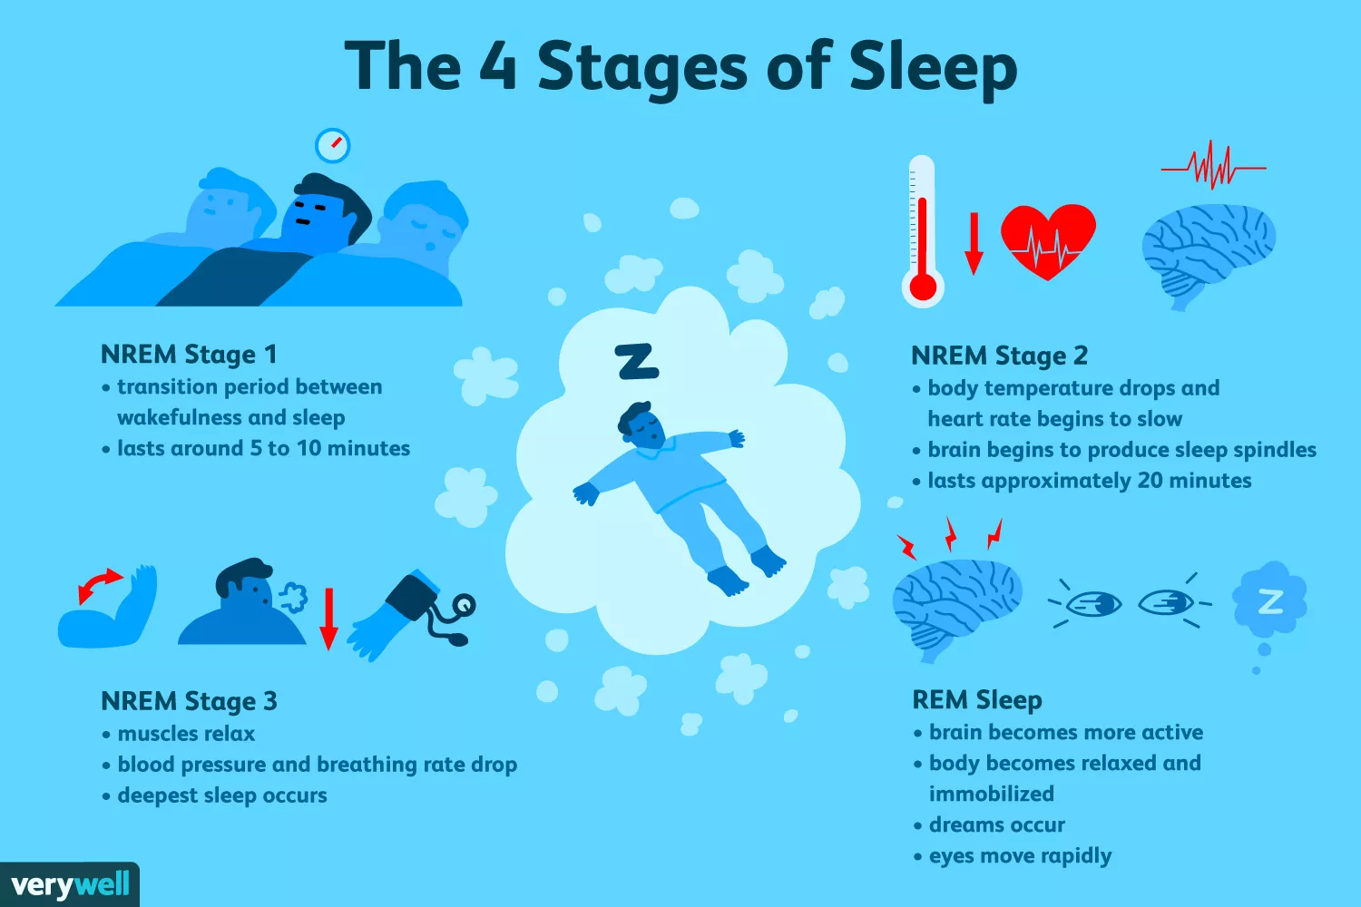

Slide 25
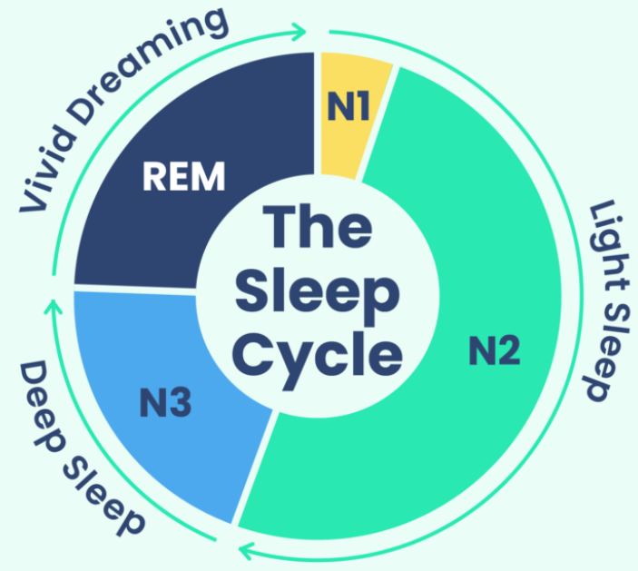
Sleep Cycle

Slide 26
NREM Stage 1
The first stage of the sleep cycle is a transition period between wakefulness and sleep.
During stage 1 sleep:
Your brain slows down
Your heartbeat, your eye movements, and your breathing slow with it
Your body relaxes, and your muscles may twitch
This brief period of sleep lasts for around five to 10 minutes.
The brain is still relatively active.

Slide 27
NREM Stage 2
People spend about half of their total sleep time during NREM stage 2, which lasts for about 20 minutes per cycle.
During stage 2 sleep:
You become less aware of your surroundings
Your body temperature drops
Your eye movements stop
Your breathing and heart rate become more regular

Slide 28
NREM Stage 3
This is a period of deep sleep where any environmental noises or activity may fail to wake the sleeping person.
During NREM stage 3 sleep:
Your muscles are completely relaxed
Your blood pressure drops and breathing slows
You progress into your deepest sleep
During this deep sleep stage, your body starts its physical repairs.
Getting enough NREM stage 3 sleep makes you feel refreshed the next day.

Slide 29
Stage 4: REM Sleep
While your brain is aroused (wake up) with mental activities during REM sleep, the fourth stage of sleep, your voluntary muscles become immobilized.
During REM sleep, your brain’s activity most closely resembles its activity during waking hours.
However, your body is temporarily paralyzed.

Slide 30
Cont’d...
REM sleep begins approximately 90 minutes after falling asleep. At this time:
Your brain lights up with activity
Your body is relaxed and immobilized
Your breathing is faster and irregular
Your eyes move rapidly
You dream

Slide 31
STEPS TO GETTING A GOOD NIGHT SLEEP
Learn to value sleep. We never accomplish what we do not value
Establish a regular bedtime ritual to let your mind and mind and body know that you are preparing to sleep.
Exercise appropriately every day at least four to five hours prior to retiring.
Establish regular time for rising and retiring and stick to them every day even on weekends
Eat lightly in the veining (arranging) several hours prior to bedtime.

Slide 32
Cont’d...
Avoid watching exciting or depressing tv programs or movies engaging in stressful events such as arguments or making momentous decision soon before bedtime.
Avoid the use of sleeping medication like caffeine and alcohol which disrupt normal sleep architecture.
See your personal physician if you suspect a sleep disorder or other medical condition.
Put your trust in God give him your problem and anxieties.
Remember: Tonight’s sleep builds tomorrow’s energy!

Slide 33
WEEKLY AND ANNUAL REST.
As humans we all have our limitations.
We cannot walk around the clock or without regular time of rest and maintain a healthy, happy and productive life.
We need daily rest as much as we need weekly and annual breath to provide the mental and the emotional recuperation necessary for creativity and positive family relationships.
Optimal physical mental, emotional and spiritual health require adequate rest.

Slide 34
Air
Genesis 2:7; Then the LORD God formed the man from the dust of the ground.
He breathed the breath of life into the man’s nostrils, and the man became a living person.
Clean air is essential and constitutes the physical breath of life.

Slide 35
How does air work?
Atmospheric air comprises a mixture of gases: oxygen (O2), carbon dioxide (CO2), nitrogen (N2), inert (inactive) constituents such as argon and helium.
Oxygen is the vital component of air that sustains life.
Breathing is the process that moves the air in and out of the lungs and continues the cycle of taking in oxygen and releasing carbon dioxide.
This process takes in and exchanges approximately 20,000 liters of air daily.

Slide 36
Cont’d...
The body carries approximately two quarts of oxygen in the lungs, blood, and other tissues at any given time.
Once oxygen enters the lungs, it goes into the bloodstream by a process called diffusion.
The heart and circulatory system then pump the blood to every tissue of the body, delivering life-giving oxygen to the tissues and cells.

Slide 37
Cont’d...
The waste carbon dioxide is released into the air sacs and expelled from the lungs.
The oxygen is carried by millions of red blood cells, which nourish all the body tissues and cells.
If one does not inhale fresh air, the level of carbon dioxide builds up in the blood, resulting in the feeling of tremendous “air hunger” forcing one to breathe.
Brain cells begin to die within four minutes of oxygen deprivation.
“It’s a matter of life and breath.” We need oxygen for life, and pure fresh air for health.

Slide 38
How does exercise change things
During rest, the breathing rate is lower because the carbon dioxide production is lower. Control mechanisms, however, ensure adequate breathing to provide appropriate amounts of oxygen to all body cells.
In addition to removing carbon dioxide from the body, breathing results in a loss of water from the body in the form of water vapor.
This is one of the forms of “invisible” water loss, so named because it is not seen or obvious.
Prolonged, rapid, deep breathing can aggravate dehydration; this may occur in prolonged exercise, heat exhaustion, and disease states.

Slide 39
Do not skimp (hesitate) on quality
High quality fresh air is pure and clean.
The life-giving oxygen molecules should be unpolluted.
Deep breathing of fresh air imparts an improved sense of well- being. It increases the rate and quality of growth in plants and animals.
It improves the function of the lung’s protective cilia.
These are the microscopic, fine, hair-like structures that help to keep dust and fine particles as well as irritants from entering the lungs.

Slide 40
Cont’d...
Good oxygenation lowers the body temperature and resting heart rate, and decreases the survival of certain bacteria and viruses found in the air.
Fresh air is often destroyed and polluted. This can occur through inadequate ventilation of dwellings, especially where open cooking fires and stoves are used.

Slide 41
Protecting our interest
The air also has many protective qualities. On a global level the air and its suspended water vapor protect the earth and its inhabitants from solar radiation and the cold vacuum of outer space.
The air recycles water and many chemicals to moderate the climate.
Within this atmospheric envelope, life is found over a very wide range of altitudes and temperatures.

Slide 42
Air pollution
Air pollution refers to the presence of harmful substances in the Earth's atmosphere, which can have detrimental effects on human health, the environment, and the overall quality of life.
These substances, known as air pollutants, can be natural or human-made and are released into the air through various sources

Slide 43
Cont’d...
The WHO estimates that more than 2million people die every year from breathing in tiny pollutant particles present in indoor and outdoor air pollution.
The tiny particles can penetrate the lungs and may enter the blood stream causing heart diseases, lung cancer, asthma, and acute lower respiratory infections.
Some six million people, mostly children, die each year from acute respiratory infections, complicated by indoor pollution often originating from unvented or poorly vented cooking facilities.

Slide 44
Cont’d...
Children are victims of secondhand smoke in homes where parents and other family member smoke.
Smoke pollution in the work place increases the risk of non smokers developing lung cancer.

Slide 45
In the beginning
God has created the earth along with the surroundings and the atmosphere with the air we breath.
Indeed Lord God our creator made a man of the dust of the ground, and breathed into his nostrils the breath of life; and man became a living being (Gen. 2:7).
We need to breath deeply, exercise well, enjoy the beauty of the great outdoors, and never forget the indwelling presence of God, the breath of Life.

Slide 46
temperance
Temperance is a concept that refers to the moderation, self-restraint (self-control, self-discipline), and balance in one's actions, emotions, or desires.
It is often associated with the idea of exercising control over oneself and avoiding extremes.
It is seen as a means of achieving inner harmony and avoiding excesses that can lead to negative consequences. By practicing temperance, individuals strive to find a balance between their desires and their actions, avoiding both indulgence and deprivation.

Slide 47
Cont’d...
Some people lose their jobs, financial security, many friends with whom you play with and drink because of drunkenness.
Not only alcohol but cigarettes as well as it can provoke a lung cancer after all consequences is where people start stopping.

Slide 48
The meaning of temperance
Temperance means different things to different people. To achieve true balance in life we need to address all aspects of living ; balance in all things is needed.
People continue with their habit of taking tobacco and it is legally with few restrictions, therefore it becomes like a culture in some societies worldwide despite the fact that they are the leading and third leading causes of preventable deaths.

Slide 49
Alcohol consumption and global health
Alcohol consumption vary widely between countries, depending on cultural traditions. Alcohol like tobacco is being exported to developing countries, adding huge burden to already inadequate health systems according to WHO, 2011.
Approximately 2.5 million people die from alcohol related causes each year.
Fifty five percent of adults have consumed alcohol
4% of all deaths are related to alcohol true injuries, cancer, cardiovascular diseases and liver cirrhosis.
Globally 6.2% of male deaths are related to alcohol and 1.1% of female deaths.
One in five men in Russia federation and neighboring countries die from alcohol related causes.

Slide 50
Risks of Alcohol addiction
Alcohol is a known addictive substance the likelihood of becoming an alcoholic depends on numerous factors. The chance of alcoholic developing over a lifetime is 13%.
In case of the existing drinkers in the family such as uncle, father, mother, aunt, grandparent, the percentage doubles.
If the experimentation begins under the age of 14 years, the % chance of dependance increase to 40%-plus. This demonstrates the importance of alcohol education from an early age.
Social support develops resilience, enabling youth to cope with difficult decisions and choices despite peer pressure.

Slide 51
Alcohol and cancer
Cancer is one of the leading cause of death globally. There are many examples of the relationship between drinking alcohol and cancer.
In Europe cancer is the second most common cause of death, with 2.5million cancer deaths per year and people do not believe that there is a connection between alcohol and cancer.
Thus being ignorant does not spare us the consequences.

Slide 52
Alcohol and society
It is known that alcohol use is associated (often causal) with accidents of all kinds, such as road fatalities, as well as domestic violence, murder, rape, and other criminal activities.
Heroin, crack, cocaine and methamphetamine were the most harmful drugs to individuals.
Alcohol is also the leading cause of preventable mental retardation in the world. This is because alcohol readily crosses the placenta and damages the developing brain of the unborn baby.
Again, there is no safe level of alcohol consumption during pregnancy.

Slide 53
Alcohol and heart health
Alcohol and its relationship with heart health is a topic that has been studied extensively over the years.
The effects of alcohol on the cardiovascular system can be complex and depend on several factors, including the amount of alcohol consumed, individual health status, and other lifestyle factors.

Slide 54
Cont’d...
Moderate Alcohol Consumption: some researchers confirm that moderate alcohol consumption has been associated with a reduced risk of certain cardiovascular conditions, particularly coronary heart disease.
They again suggested that moderate alcohol intake may have protective effects on the heart
Risks of Excessive Drinking: While moderate alcohol consumption may have some potential benefits, excessive drinking or heavy alcohol consumption can be detrimental to heart health.
Heavy drinking is associated with an increased risk of high blood pressure, heart failure, stroke, and irregular heart rhythms.

Slide 55
Cont’d...
In summary, taking into account the significant health risks related to alcohol use it does not make sense to promote its use for heart, especially when there are proven and safe intervention such as daily exercise and healthful diet.

Slide 56
Killer tobacco
Tobacco use is a significant public health concern, and it is widely known to be harmful to human health.
Smoking tobacco, in particular, is a leading cause of preventable diseases and premature death worldwide.
Health Risks: Tobacco use is strongly linked to numerous health risks, including several types of cancer (such as lung, throat, mouth, and pancreatic cancer), cardiovascular diseases (including heart disease and stroke), respiratory conditions (such as chronic obstructive pulmonary disease - COPD), and other serious health problems.

Slide 57
True balance in living
True balance in living refers to achieving a state of equilibrium and harmony across different aspects of life, such as work, relationships, personal well-being, and leisure (enjoyment).

Slide 58
Cont’d...
Time Management: Effectively managing your time can contribute to a sense of balance.
Prioritize tasks, set realistic goals, and practice time-blocking techniques to ensure a healthy distribution of your time and energy across different activities.

Slide 59
Cont’d...
Prioritization: Identifying and prioritizing your values and goals can guide you in making decisions and allocating time and energy to the areas that matter most to you.
Flexibility and Adaptability: Life is dynamic, and circumstances may change.
Cultivating flexibility and adaptability can help you navigate unexpected challenges and transitions.

Slide 60


